Slide 1




Agile Presentation
By Steven Armenta
CS 250
7-1 Final Project

Slide 2





AGENDA
Agile Team Roles
Agile Phases
Waterfall method
Agile or Waterfall

Slide 3




BACKGROUND
This presentation provides an overview of the Scrum-Agile methodology, highlighting it’s key principles and comparing the process of Agile development with the traditional Waterfall approach.

Slide 4
Agile Team Roles

Slide 5


AGILE TEAM ROLES
Scrum Master
Ensure Agile practices is understood and practiced by the team and organization.
Ensures the Scrum team follows Scrum rules and coaches team members on Scrum methodology.
Works with Development team members such as Product Owner to manage Product Backlog.
Removes challenges and blockers that hinder the team.
Facilitates Scrum events such as the Daily Scrum.
Tester
Develop Test cases and defines user acceptance criteria and acceptance tests.
Clarifies ambiguity found in the development teams code and user stories.
Communicates with the Product Owner related to User Stories and development of Test cases ensuring development is accurate.
Collaborates with the Development team to resolve any issues and defects related to testing.
Developer
Designs, develops and delivers the code for the product.
Collaborates with the Scrum master, Product Owner, and Tester in Scrum events such as the Daily Scrum and communicates challenges.
Self-organizes and takes ownership of their work and collaborates with other developers to create a high-quality product.
Product Owner
Connects the Client and team by owning and managing the Product Backlog.
Is accountable for the team and decisions the team makes.
Maximizes the value of the product and the work done by the development team by communicating the product vision and goals.
Provides clarification for the Scrum team related to the Product Backlog and user needs.

Slide 6
Agile Phases

Slide 7
PHASES OF THE SDLC IN AGILE
PHASES OF THE SDLC IN AGILE
SDLC PHASES
Planning
SCRUM-AGILE METHODOLOGY
Requirements
Flexible, iterative improvement method that focuses on short continious improvement.
Design
Flexible process allowing for frequent interuptions and adaptations pivoting development focuses.
Development
Testing
Trial and error practices where improvement is continuously learned.
Deployment
Information and best practices are developed by means of experimenting and observing.
Maintenance
The phases of SDLC are cyclical rather than a straight lined linear approach such as other methodologies like waterfall.

Slide 8


AGILE PHASES
Planning
Sprint Planning
This Scrum event takes place at the beginning of each Sprint.
Product Owner and team discuss user stories that will be worked on during the Sprint. Team defines the tasks that will need to be accomplished during the sprint to achieve the user stories.
Team members will be assigned and take responsibilities of specific tasks.
Requirements
Defined as project progresses through sprint.
Product Backlog is created.
Prioritiuzed list of work to be done.
The Product Backlog is made of user stories.
Continously being updated by the Product Owner.

Slide 9
AGILE PHASES
Design, Development, and Deployment
These stages are done simultaneously within each Sprint cycle.
Sprints last between 1 to 4 weeks ending with a Sprint Review and Sprint Retrospective.
Daily Scrum event helps to monitor progress of the team and identify any obstacles that may slow down progress.
Team showcases work accomplished to stakeholders at the end of the Sprint during the Sprint review
Team discusses what to stop doing and what to continue doing in the next sprint during Sprint Retrospective.

Slide 10


AGILE PHASES
Final Deployment and Maintenance
Final Sprint Review and Retrospective will take place which will help the team gain velocity and provide a more effective product that meets current client requirements.
Once the product is released and users have a chance to use it, the product is deployed and maintenance phase begins.
During the maintenance phase, the product is updated, for the customer and as issues arise additional improvements are taken into account for future sprints.

Slide 11
Waterfall

Slide 12
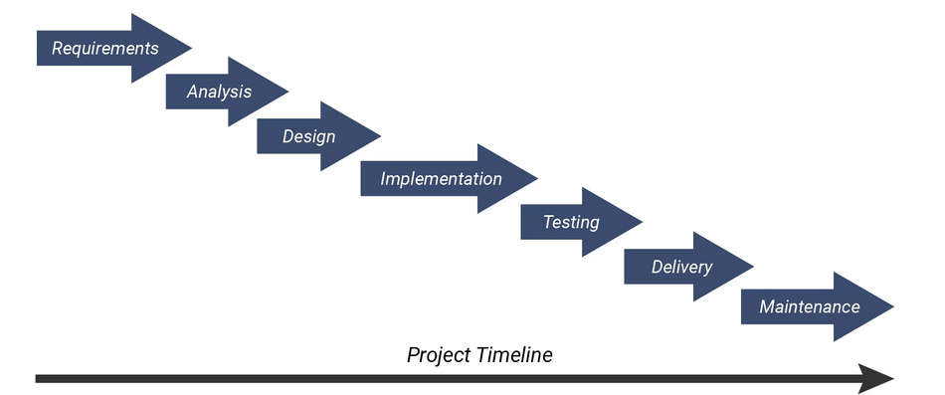
WATERFALL METHOD
Traditional linear development model with an objective to achieve for each phase of development.
Linear, sequential, and plan driven long term model.
Requires length documentation and planning prior to starting any development.
Each phase must be completed before next phase begins.

Slide 13
WATERFALL METHOD
Waterfall method Applied
If the Waterfall method would have been applied for SNHU Travel project, the system would have looked very different on the products completion date.
Requirements would have been defined before development occurred and no customer feedback would have been applied until finished product was created.
This would mean the changes would be difficult to apply as the project progressed.
Development would have to be completed prior to Testing.
Creating updates after development makes it harder to go back and fix issues as the team would have to go back through each phase of waterfall.
Implementing Agile for SNHU Travel project was more effective than Waterfall as the Requirements changed mid project and the product was pivoted to Wellness and this flexible approach would not have been developed if using the Waterfall method.

Slide 14
Deciding between
Waterfall & Agile

Slide 15
DECIDING BETWEEN Waterfall & Agile
Factors to Think About:
Predictability
Waterfall: Requirements are easily defined up front and there is a clear agreement on the final product vision. No changes should be expected.
Agile: Requirements are defined as more information is gathered as the product progresses with each Sprint cycle. Final product vision difficult to determine at the start.
Client Involvement
Waterfall: Project is defined early on so client is not very involved after gathering requirements.
Agile: Project has high collaboration with client to develop a high-value product aligned with user needs.
Timeline
Waterfall: Fixed timeline, can go over timeline if phases have to be restarted.
Agile: Flexible, easier to adjust timeline that has rapid development cycles of one to four weeks.

Slide 16
SUMMARY
In conclusion,
The Scrum-Agile approach was the more effective and efficient approach for the SNHU Travel project. The team was able to develop a higher quality product due to the engagement of the client and Agile’s flexible format that allowed for phases to be progressed through simultaneously. It is my recommendation that ChadaTech should make the transition to the Scrum-Agile based approach as the team would be able to produce a higher-quality product. Furthermore, Chadatech would be able to develop future products in a more rapid efficient manner and be able to improve practices amongst the team by following Agile principles.

Slide 17
Thank You

Slide 18
REFERENCES
The 3 Scrum Roles and Responsibilities, Explained. (2024, October 28). Coursera. https://www.coursera.org/articles/scrum-roles-and-responsibilities
actiTIME. (2022, March). Waterfall Model: What Is It, When and How To Use It? ActiTIME.com. https://www.actitime.com/project-management/what-is-waterfall-model
‌
Coursera. (2023, November 29). What is Agile? A beginner's guide. https://www.coursera.org/articles/what-is-agile-a-beginners-guide
Towner, J. (2022). What is the Difference Between Agile and Waterfall? Www.forecast.app. https://www.forecast.app/blog/difference-between-agile-waterfall
‌

